Slide 1

Union Grove Middle School
2021-2022
Comprehensive School
Counseling Plan
Ms. Blake, Mrs. Mullvain & Ms. Richards

Slide 2
VISION
Union Grove Middle School’s counseling department is committed to empowering our Wolverines to become confident and resilient leaders who exceed Above and Beyond expectations.
Notes:
Gullatt

Slide 3
Mission
The Union Grove Middle School Counseling Program is dedicated to promoting the health and wellness of our students by providing a comprehensive program which is aligned to the American School Counseling National Model. Services provided include:
Core curriculum lessons
Responsive services
Small group counseling (needs based)
College and career readiness
Schoolwide initiatives (You Matter, Red Ribbon Week, Kindness Week, etc.)
Community education
Notes:
Gullatt

Slide 4
Belief Statements
School Counselors at Union Grove Middle School believe:
All students have the ability to meet or exceed academic standards in each grade level.
All students benefit from the implementation of an effective Comprehensive School Counseling Plan.
School Counselors are leaders who are responsible for advocating for all students and promoting student achievement.
Notes:
Gullatt

Slide 5
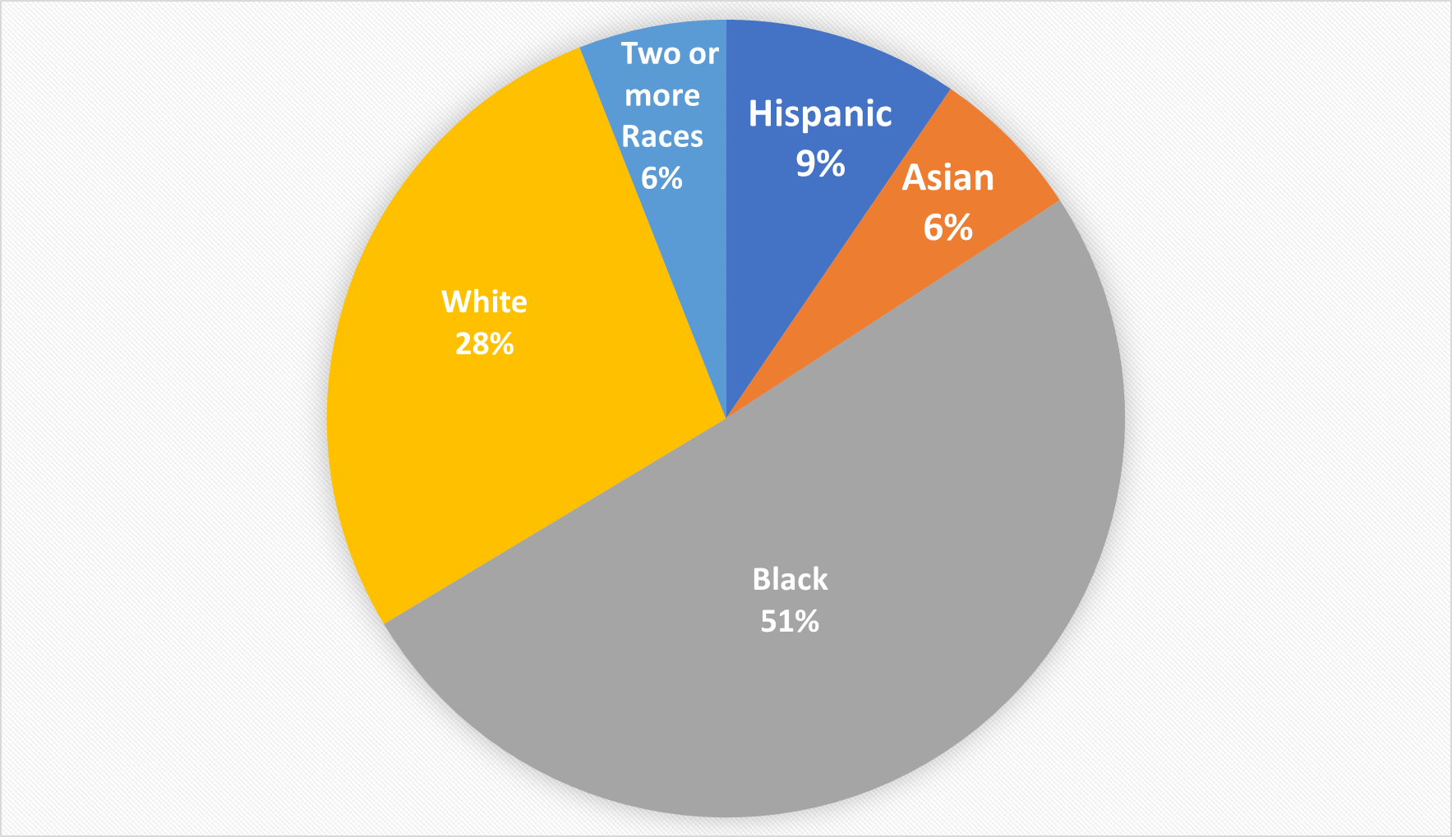
Union Grove Middle School 2021-2022 Demographics
6th grade: 334
7th grade: 343
8th grade: 396
Total - 1073
Notes:
Lawson

Slide 6
Union Grove Middle School Needs Assessment Results Sept. 2021
Top 3 Responses:
I need help improving my studying and test taking skills. 50%
I need help dealing with anger. 44%
I need help dealing with feelings of sadness or depression. 36%
Notes:
Lawson

Slide 7
UGMS CSCP Aligned with HCS
District Strategic Plan
District Priority Outcome #2: To advance opportunities, access, and outcomes for every student group in Readiness to Learn at every level.
Student participation in advanced coursework at every level.
Students demonstrating social and emotional health and readiness

Slide 8
Comprehensive School Counseling Plan
School Level Goal #1
ASCA Domain: Academic Development
School Level Goal : Increase the number of students in 6th - 8th grade with proficiency level of proficient or above on the 2022 ELA Milestones assessment from 52% - 55%.
National Standards:
Academic Development - A:A1.5 Identify attitudes and behaviors that lead to successful learning.
Mindset Standards: M4 - Self confidence in the ability to succeed.
Notes:
Lawson

Slide 9
School Level Goal #1 (Academic)
To increase the number of students in 6th - 8th grade with scores of proficient or above on the 2022 Georgia Milestones ELA assessment from 52% - 55%.
Participation Data | Timeline | Activities | Artifacts | Evidence
Needs Assessment | August 2021 | Students take a needs assessment | Needs Assessment | Results from Needs Assessment
Core Curriculum Lessons | Monthly | Study Skills, Test Taking, Organization | Student participation | Teacher feedback MAP DATA
Individual Counseling | On-going | Support, Prevention, Interventions, Resources | Counseling Notes, Resources | Counselor Meeting Request Forms, Counseling Notes-if needed, Follow-ups
Small Group Counseling | On-going | Supportive, Preventative, Intervention | Resources, Collaboration | Follow-up surveys
Notes:
Lawson

Slide 10
School Level Goal #1 Summary Data (Academic)
Participation Data | Intervention | Outcome Data
6th Grade | Organization/Study Skills Group Academic Planning with students failing | grades, assessment scores
7th Grade | Tier 1 - Core Curriculum Lesson - Effective Communication Tier 2 - Strong Girls Group Tier 3 - Academic Action Planning with students failing 2 or more subjects | pre/post tests; observation; grades
8th Grade | Coping Skills Group Academic Planning with students failing | pre/post tests; observation; grades
Notes:
Lawson

Slide 11
2021 - 2022 UGMS School Outcome Data Summary for ELA (Grades 6-8)
fffffffaaaaa
2020-2021 Ga Milestones ELA Data | 697 students were tested 43% of those students tested at UGMS scored Proficient in ELA 9% of students tested were Distinguished Learners in ELA Total of 52% of learners scored proficient or above on the 2021 ELA GAMS
2021-2022 Ga Milestones ELA Data | 1,042 students were tested 40% of those students tested at UGMS scored Proficient in ELA 9% of students tested were Distinguished Learners in ELA Total of 49% of learners scored proficient or above on the 2022 ELA GAMS.
Notes:
Lawson

Slide 12
UGMS CSCP Aligned with HCS
District Strategic Plan
District Priority Outcome #3: We will advance opportunities, access, and outcomes for every student group in College, Career, and Life Ready skills-post graduation.
Students Completing Career Inventories, Internships/Apprenticeships, and Industry Certifications
Students Demonstrating Financial Literacy, Soft Skills, and ESE Students Mastering IEP Transition Goals)
Participation in and Performance on PSAT

Slide 13
Comprehensive School Counseling Plan
School Level Goal #2
ASCA Domain: Career Development
School Level Goal : We will have 100% of all 6th - 8th grade students complete designated tasks to fulfill Georgia Bridge Bill requirements through Henry Futures.
National Standards:
Career Development - C:A1.3. Develop an awareness of personal abilities, skills, interests and motivations.
Mindset Standards: M7. School counseling programs promote and enhance academic, career and social/emotional outcomes.

Slide 14
School Level Goal #2 (Career)
100% of all 6th - 8th grade students will complete designated tasks to fulfill Georgia Bridge Bill requirements through Henry Futures.
Strategies | Timeline | Activities | Artifacts | Evidence
Career exploration and post secondary requirements | Varies by grade level | Core curriculum lessons completing Henry Futures career exploration activities Tour of Academy of Advanced Studies | Student dashboard activity report | Student dashboard activity report
College experiences | Throughout the year | Information sessions with admissions counselors | Student sign ups, post activity surveys | Participation reports, post event surveys
Notes:
Lawson

Slide 15
School Level Goal #2 Summary Data (Career)
100% of all 6th - 8th grade students will complete designated tasks to fulfill Georgia Bridge Bill requirements through Henry Futures.
Grade Level | Activities | Complications
6th Grade | 75% of students completed all of the required Henry Futures Tasks (Naviance) | Difficulty with finishing tasks Required tasks not grade level appropriate
7th Grade | 94% of students completed all of the required Henry Futures Tasks (Naviance) | Student attendance
Notes:
Lawson

Slide 16
School Level Goal #2 Summary Data (Career)
100% of all 6th - 8th grade students will complete designated tasks to fulfill Georgia Bridge Bill requirements through Henry Futures.
Grade Level | Activities | Complications
8th Grade | 70% of students completed all of the required Henry Futures Tasks (Naviance) 100% of students had access to two virtual college informational sessions (Fort Valley State University and Florida Agricultural & Mechanical University (FAMU) 100% of students received core curriculum lessons on high school requirements, opportunities for advanced placement, information on the Academy for Advanced Studies, and summer school learning opportunities 100% of students received core curriculum lessons on completing Individual Graduation Plans (IGP’s); 85% of 8th grade students completed their Individual Graduation Plan (google form) | Students may have completed the task, but did not complete the survey Attendance For IGP’s: google form from middle school in addition to the google form/plan from the high school
Notes:
Lawson

Slide 17
UGMS CSCP Aligned with HCS
District Strategic Plan
District Priority Outcome #2: To advance opportunities, access, and outcomes for every student group in Readiness to Learn at every level.
Student participation in advanced coursework at every level.
Students demonstrating social and emotional health and readiness

Slide 18
Comprehensive School Counseling Plan
School Level Goal #3
ASCA Domain: Personal/Social Development
School Level Goal : From first semester to second semester there will be a decrease for students receiving in school suspension.
National Standards: Personal/Social Development:
PS:B1.6 Know how to apply conflict resolution skills.
PS:B1.10 Develop an action plan to set and achieve realistic goals.
Mindset Standards: M1. Belief in Development of whole self, including a healthy balance of mental, social/emotional and physical well being

Slide 19
School Level Goal #3
(Personal/Social Emotional)
There will be a 3% decrease for the number of students receiving in school suspension from the 2020-2021 school year to the
2021-2022 school year.
Strategies | Timeline | Activities | Artifacts | Evidence
Needs Assessment | August 2022 | Students complete a needs assessment | Needs Assessment | Results from Needs Assessment
Individual Counseling | On-going | Support, Prevention, Interventions, Resources | Counseling Notes, Resources | Counseling Notes, Follow-ups
Group Counseling | On-going | Supportive, Preventative, Intervention | Resources, Collaboration | Follow-up surveys
Core Curriculum Lessons | Once a month | Needs Assessments, teacher/staff observations | Behavior Reports | Number of office referrals each term

Slide 20
School Level Goal #3
(Personal/Social Emotional)
There will be a 3% decrease for the number of students receiving in school suspension from the 2021-2022 school year to the 2022-2023 school year.
Grade Level | Activities
6th Grade | Classroom Core Curriculum Lessons Meet the Counselor Second Step Lessons Teacher Referrals Small Group- Emotional Management Celebrations
7th Grade | Tier 1 Classroom Core Curriculum Lessons: Meet the Counselor, Managing Emotions, Coping Skills, Effective Communication, Second Step Tier 2 Strong Girls - Small Group Tier 3 Individual meetings for immediate needs ie, cool down, conflict resolution, peer mediation
8th Grade | Classroom Core Curriculum Lessons Second Step Lessons Teacher Referrals Small Group Counseling-Coping Skills; managing emotions Individual Counseling

Slide 21
Union Grove Middle School Needs Assessment Results Sept. 2022
Top 3 Responses:
I need help improving my studying and test taking skills. 50%
I need help reducing test anxiety. 37%
I need help dealing with I need help exploring future careers. 34%
Notes:
Lawson

Slide 22
Implications for the 2022-2023 School Year
Social Emotional/Behavioral
To reduce the number of students serving In School Suspension (ISS) by 5% from the 2018 - 2019 (pre-COVID)school year (224 students) to the 2022-2023 school year (212 or fewer students).
(Tier 1) Core curriculum lessons - Managing Emotions and Effective Communication.
(Tier 2 & 3): Check-ins (weekly, bi-weekly, or monthly); small group interventions; teacher input

Slide 23
Implications for the 2022-2023 School Year
Career Planning
To have 100% of 6th-8th grade students complete all required Bridge Bill tasks.
(Tier 1) Core Curriculum Lessons (Naviance), Information shared with parents (website, parent nights)
(Tier 2 & 3): Follow up with incoming students; ensure students complete surveys to mark task as completed.

Slide 24
Implications for the 2022-2023 School Year
Academic
To increase the number of students enrolled in at least one advanced course from a baseline of 12%
(18/19sy - 21/22sy) to 32% in 22-23sy.
(Tier 1):
Provide additional opportunities for advanced coursework.
Communicate with UGHS to ensure course offerings align with available pathways at UGHS.
Core Curriculum lessons informing students of opportunities for advanced level coursework and high school graduation requirements.
Providing communication to parents about advanced level coursework.
(Tier 2 & 3): Identify incoming students that would be eligible to take advance coursework by reviewing MAP scores, Georgia Milestones, and grades

Slide 25
Union Grove Middle School
2021-2022
Comprehensive School
Counseling Plan
Thank you!

